Slide 1




Child Sexual Exploitation (CSE)
Safeguarding Children and Young People
Kelly Gallagher PSNI
Aisha Sloan NHSCT
Therese Moran EANI

Slide 2
CONTENT
CSE Definition and how it happens
Challenges for professionals
Discovery vs disclosure
Barriers to disclosure
The Grooming Process
The impact of CSE on victims
How to support a child and their family
CSE and the Internet
CSE Framework in NI
CSE and the law
Case Studies
Boys and young men

Slide 3
CSE Definition
SBNI Online Policy and Procedures
Child sexual exploitation is a form of child sexual abuse. It occurs where an individual or group takes advantage of an imbalance of power to coerce, manipulate or deceive a child or young person under the age of 18 into sexual activity
(a) in exchange for something the victim needs or wants, and/ or
(b) for the financial advantage or increased status of the perpetrator or facilitator.
The victim may have been sexually exploited even if the sexual activity appears consensual. Child sexual exploitation does not always involve physical contact; it can also occur through the use of technology.

Slide 4
Understanding CSE
Victims are both male and female
16/17 year olds, though legally able to consent to sexual activity, can also be sexually exploited
It is still abuse, even if it appears consensual
Children in Care, Children at home
Can take place in person and via technology, or a com=bination of both

Slide 5
Perpetrators of CSE
Can be perpetrated by individuals or groups
  Males or females
    Peers or adults
Can be a one-off occurrence or a series of incidents over time
  Can range from opportunistic to complex organised abuse

Slide 6
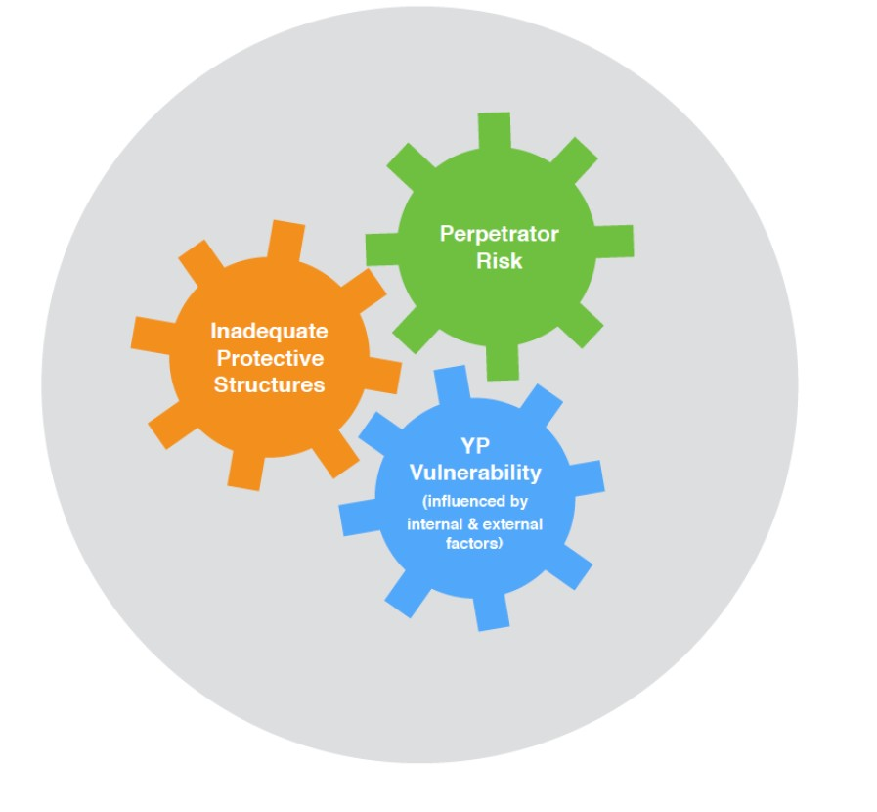
How does it happen?

Slide 7
Challenges for professionals
CSE can be difficult to identify
CSE is associated with a number of legal offences.
Young people rarely report CSE - so professionals need to be actively looking for and reporting it.

Slide 8
Discovery vs Disclosure
What is common across all forms of CSE is the rarity with which young
people disclose what is happening to them”
Dr. Helen Beckett (University of Bedfordshire)

Slide 9
Discovery
In the majority of cases, the abuse of a child will be discovered, perhaps via a 3rd party or from images found on a device.
The child will not have had a chance to prepare themselves to discuss issues that they may find embarrassing and personal.
They may not even know the words to use to describe the abuse and will not have had time to find and understand these words.
These feelings, combined with the possible fear of the offender or the reactions of others, will increase the likelihood that the child will not want to talk about the abuse and may be more inclined to deny, say that it was consensual, or refuse to engage.

Slide 10
Disclosure
Disclosure is where the child has told or indicated to a person what has happened to them, sometimes in full, but often only part of the picture.
Disclosure should be seen as a process rather than a one-off event, with the child working out what has happened, how to tell and whom they can trust.
Disclosure may not be deliberate - abuse may be identified through conversations with the child.
NB. The child’s account should not be probed - this will be done by specially trained Police Officers and Social Workers during Achieving Best Evidence (ABE) interview.
Notes:
Who what Where When questions are ok to ask
Refer to the Marie Collins Foundation article on School Development Service (SDS) learning portal: ‘Discovery vs Disclosure’ for further reading.

Slide 11
Barriers to disclosure
The child has been groomed not to tell – shame, fear, being told to keep it a secret or believing they are to blame
They might not recognise they are being groomed and may see the offender as a friend/boyfriend/girlfriend
Additional challenges when it is online – easier for the offender to be secretive by lying about their age or identity
Offenders often request indecent images to prevent disclosure. It is unlikely a child will tell you they have been abused online – more likely to be discovered by somebody

Slide 12
Use of drugs or alcohol without known
funds
History of sexual abuse/previous CSE
Receipt of unexplained gifts
Collected/dropped off by car by unknown adults
Risky internet and webcam use
Gang association
Inappropriate sexualised behaviour
Homelessness and sofa surfing
Sudden change in type of clothing being worn
Young people with a strong desire/need for money
CSE INDICATORS AND VULNERABILITIES
Missing and/or truanting episodes
Young people who are trafficked
History of neglectful and/or emotionally abusive care
Low self esteem
and aspirations
Poor relationships with peers or family
Association with risky adults/peers
Hanging out in areas known to be risky
Substance misuse Friends with other victims of CSE/CCE
LAC
Disclosed relationship with older adult
Carrying weapons
Physical symptoms eg sexually transmitted infections, pregnancies or bruising suggestive of physical or sexual assault.
Notes:
Risks and Vulnerability

Slide 13
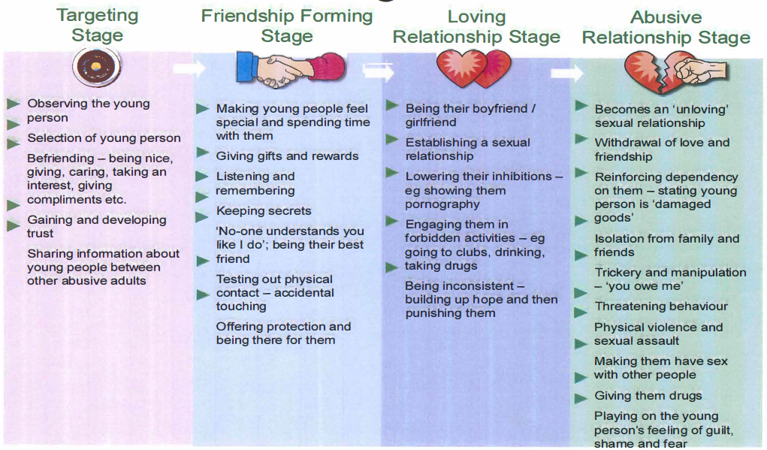
Grooming Process
Notes:
Increasingly – technology assisted CSE goes from Stage 1 to Stage 4 very quickly

Slide 14
Responding to Disclosure
Receive
Listen actively, open body language, accept, non- judgemental
Reassure
You’ve done the right thing by coming to me’, re-assure YP that you have listened and hear what they are saying; Don’t promise what can’t be delivered. Be mindful the child may have been threatened and might be fearful to share information.
Respond
Tell them what you are going to do and do it. Ensure YP is ok before leaving
Report
As soon as possible, to Gateway Services (Single Point of Entry)
Record
Vital – facts, no opinions – When? Where? Who? What?

Slide 15
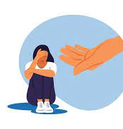
Worried?
The teacher/professional who receives the information should refer to Designated Teacher for Child Protection / line manager
Discuss with EA CPSS as needed
Complete a UNOCINI Referral to Gateway/Police – detailing the concerns and all relevant information
Notes:
In some urgent situations – where clear evidence of criminality - straight to Central Referral Unit CRU. AND refer to Gateway

Slide 16
STOP AND THINK!
LANGUAGE WE USE…

Slide 17
Language and Labelling
Inappropriate term:
‘Sexual Activity with…’ implies consent.
Alternative: The child has been/may have been sexually abused
Concerns exist that the child may have been coerced, exploited, raped or sexually abused.
Inappropriate term:
‘In a relationship with…. ‘
Alternative: The young person has been/is being groomed, exploited and controlled. The perpetrator has manipulated the child/young person to believe they are in a relationship.
Inappropriate term:
‘Putting themselves at risk’
Alternative: There are a lack of protective factors around the child, the situation could reduce the child’s safety, there are concerns that the child may be being exploited, there are concerns regarding other influences on the child.
Inappropriate term:
They are choosing this lifestyle; lifestyle choices
Alternative: A child can never consent to their own exploitation. The child is a victim and is being sexually exploited.
Appropriate Language in Relation to Child Exploitation. The Children’s Society
Notes:
Article in the SDS portal: ‘Appropriate language in Relation to Child Exploitation’ Guidance for Professionals (The Children’s Society).

Slide 18
Impact of CSE on the victim
TRAUMA
Physical harm – e.g. injury, sexual abuse, STIs, unwanted pregnancy, genital problems, unusual discharge
Emotional harm – low self worth, self blame, poor self esteem, shame, guilt, anxiousness, withdrawn, sleep problems, impaired ability to cope with stress or emotions
Mental health – e.g. psychological harm, depression, post traumatic stress, self harm, changes in eating habits, suicidal thoughts
Relationships – more susceptible to engaging in abusive / unhealthy relationships / difficulty trusting /confused notions of relationships
Perpetration – coerce others into CSE to protect self or for own gain
Skewed boundaries – e.g. appropriate/inappropriate sexual conduct, self
protection, relationships
Behaviour problems – acting out of character, aggressive, engagement in anti-social / criminal behaviour
Problems with alcohol or drugs – addiction issues
Brain functioning – dissociation, memory problems, reduced social functioning
Notes:
ACEs And TIP

Slide 19
How to support a pupil and their family
Listen to what the young person and their family have to say
Be clear about what your concerns are
Tell the child it is not their fault and they are not to blame
Work collaboratively with the family and other professionals
Include the parents as safeguarding partners, with support they are often best placed to help their child
Help parents to understand the importance of language and attitudes
Identify key people who the family can work with
Ensure the child and their family have the right ongoing support to enable recovery
Notes:
There are articles in the EA School Development Service SDS portal where you registered – that could be shared with parents: Conversations with your child about technology assisted harm; Digital SAO. Helping my autistic child
Specialist service that support victims of CSE: Barnardos Sexual Exploitation Ends Now (SEEN) (CSE lead for each Trust is the gatekeeper for onward referral to SEEN.
PACE – Parents Against Child Exploitation –
All Trusts have a HSB team
Safety and support plan in school – talk with the CPSS for support

Slide 20
What young people affected by sexual exploitation have told us about the support they want from you

Slide 21

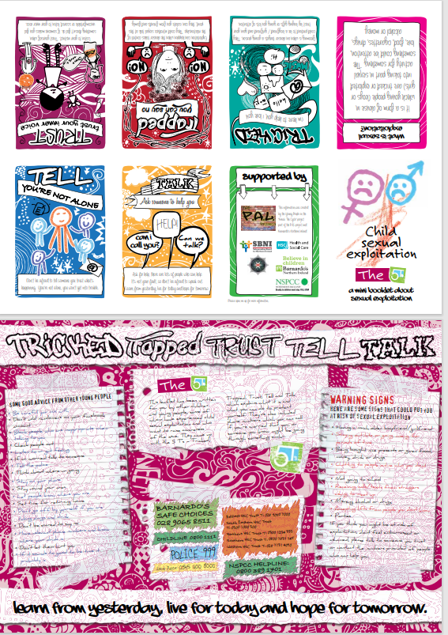
CSE Young Person’s Leaflet
https://www.safeguardingni.org/home/children-and-young-people
Notes:
#designed by and for young people – some of whom experienced CSE and want to raise awareness of the issue.
Can be downloaded and folded into a ‘booklet’.
If you were part of the SG Team 10 years ago you may have received a paper copy of this booklet during your CPSS training.
This was produced by and for young people - some of whom had experienced CSE. If followed a recommendation from the Marshall Report (2015) following and inquiry into CSE in NI.
Still available on the SBNI webpage – under (Children & Young People).
There is also a parent booklet that you can share – on the SBNI website – under Parents and Carers

Slide 22
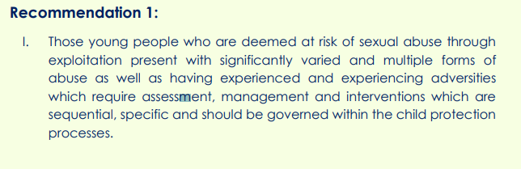
CSE as Complex Child Abuse
An Evaluation of how SBNI member agencies are effectively responding to and managing Child Sexual Exploitation within NI. SBNI & Leonard Consultancy. 2020
Notes:
All young people deemed at risk of CSE are now supported via the Child In Need of protection pathway.
If they are being supported under the LAC pathway – it will be dual process.

Slide 23
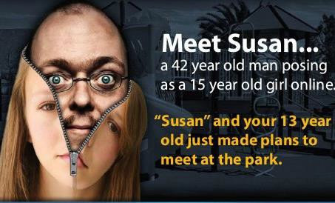
CSE and the Internet
Child Sexual Exploitation (CSE)
Notes:
This happens to boys
PSNI – Op Corin (where blackmail or sextortion - being used)

Slide 24
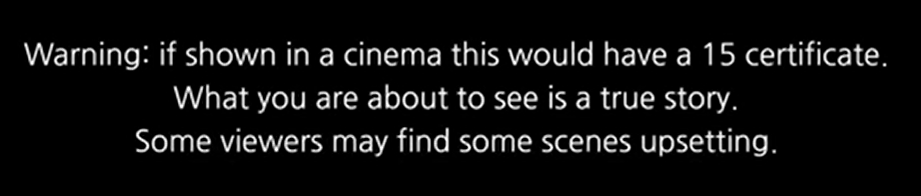
Kayleigh’s Love Story
Notes:
HEALTH WARNING! Highly emotive and may be triggering, please feel free to take time out

Slide 25

CSE FRAMEWORK in NI
Co-located Central Referral Team
Children and young persons at risk of / experiencing CSE are reviewed jointly every 8 weeks by the CSE leads within the PSNI and 5 Trust Children Services
Gather information and share information
Persons of Concern (POC) Process
Notes:
Co-located Central Referral Unit (CRU) Team
SBNI CSE Evaluation 2020. Recommendation 9
‘It is recommended a social worker is based within PSNU CRU to aid joint decision making in respect of children and young persons’ concerns to enhance information sharing and merging the shared risk’.
Might be helpful to talk about the difference co-location has made in responding to potential CSE.
SOSCARE and NICHE

Slide 26

Information sharing
Children and young people are best supported and kept safe when professionals and agencies:
Share information routinely and accurately
Share information about individual cases and wider patterns
Collaborate to ensure assessments reflect the young person’s vulnerabilities and strengths

Slide 27
Sexual Offences (NI) Order 2008
Article 17: Causing or inciting a child to engage in sexual activity
Article 19: Causing a child to watch a sexual act
Article 21: Arranging or facilitating commission of a sex offence against a child
Article 22: Meeting a child following sexual grooming etc.
Article 37: Paying for sexual services of a child
Article 40: Arranging or facilitating child prostitution or pornography
Article 58: Trafficking for the purposes of the commission of a relevant offence

Slide 28
Case Study One
A Year 11 pupil has disclosed to you that she’s worried about her friend as she’s hanging around with older men and there’s a rumour she’s sleeping with them. She’s started talking about all the money she has and suddenly has an expensive new phone.
The pupil is worried that her friend will fall out with her by telling you. She says her friend met this guy online and he introduced her to his friends. Her friend knows that she is getting new clothes, has been drinking alcohol given by this man and the pupil thinks she is in control of this situation. Her friend knows that the pupil has been sending images of herself to the man but hasn’t seen them.
Vulnerabilities:
Age
Social media usage
Not disclosing to friends – isolation socially
Signs:
New items beyond the normal means of the child or the family
Sexualised behaviour/comments
Change of peer group
Change of demeanour of child in school, for example lack of participation in after school clubs
Actions:
Report to Designated Teacher /Deputy DT/line manager, make a written record of concerns and actions. Referral to Gateway. Agree with Social Services who is going to report to parents initially and what information to be shared. SS referral – for joint discussion. There are likely offences here around the images and provision of alcohol, and considerable CSE concerns, potential for police to ID POCs.
Note all relevant info around names, times, dates, vehicles. Send to Investigating Officer/Social Worker
Safety and support plan for young person in school– call CPSS as required
Notes:
It is important to ask for the name and tel number & email address of SW and Investigating officer IO – for ease of passing on info after the referral is made.

Slide 29
Case Study Two
A pupil’s very low attendance rate has been an ongoing concern. When she does come to school she appears to be coming off substances – drink/drugs –and makes a disclosure to you about attending house parties with older males. She doesn’t think there’s anything wrong with it and sees it as a new friendship group.
After, a peer of this pupil tells you that she has also been offered a lift to parties and these men are friends of her sister, who has said she will supply all the alcohol.
Vulnerabilities:
Are they a child in care?
Any parenting/neglect indicators?
Misuse of drugs or alcohol – how are these being paid for?
Isolation from peers
Signs:
Mentioning older friends/partners
Listen out for locations, names and vehicle registration details of vehicles collecting
Look out for visible injuries, lateness, truancy, appearance – has it changed?
Watch out for fighting, changes in behaviour, slipping grades, going missing during the school day, change in friendship group or isolation from current one
Actions:
Report to Designated Teacher / Deputy DT, make a written record of concerns and actions
SS referral – whilst no clear offences noted, there are opportunities for CSE assessment, POC ID etc.
Note all relevant info around names, times, dates, vehicles
Safety and support plan for young person -call CPSS as required
Notes:
When receiving an initial update from CRU, the DT should be asking for the names and email addresses of the appointed SW and PSNI investigating officer so that further information received can be quickly shared.

Slide 30
Case Study Three
Concerns have been raised re a 14year old male pupil with ASD in a ‘relationship’ with a 17year old male pupil, suspected to be sexual and concerns are there around CSE.
The pupil is noted to be spending a lot of time online. His mum has contacted the school to say she is worried about who he is associating with and she has no control over his devices or who he is talking to.
His mum has managed to check his iPad and concerns are raised over the content he has been looking at and messages to other males which are sexual in nature. It looks as though he has arranged to meet at least one of them a few weeks ago. You are aware that this boy has started to leave school early and his friends have said he is away for spins in his new boyfriend’s car.
Vulnerabilities:
Sexuality – can he be signposted to support for this?
Is he/family known previously to SS?
ASD – YP with disabilities can often be overlooked in terms of CSE
Signs:
Constantly on the phone/very difficult to separate him from devices
Mentioning older partners/being out late
Tiredness – if he is out late at night
New items which are beyond the normal reach/means of the child and/or their family
Actions:
Report to Designated Teacher/Deputy DT/line manager make a written record of concerns and actions
SS referral – offences identified around sexual communication with a child, possibly also contact offences from meeting males too
Note all relevant info around names, times, dates, vehicles
Devices – do teachers have any power/consideration given to removing if they believe there is something evidential on it?
Safety and support plan for young person -call CPSS as required

Slide 31


PSNI: ‘OPERATION MAKESAFE’
Operation MAKESAFE
Notes:
Operation Makesafe – targeting CSE in the night time economy.

Slide 32






CSE Boys and Young Men
Notes:
The animations we are about to watch were created by the Safeguarding Board for Northern Ireland (SBNI), Youth Action NI & VOYPIC to raise awareness of Child Sexual Exploitation (CSE) as experienced by boys and young men. Boys and young men developed the animations as a way for them to raise awareness amongst their generation of the risk of sexual exploitation.
What were the key messages?
Key messages from the boys and young men were that they did not understand the term ‘exploitation’ and that it was important to explain what it was, as well as to show that it can happen to anyone in a variety of different ways, in different settings and by different types of people.
They also said that the signposting of numbers to get help in relation to CSE issues affecting boys and young men needed to be clear and not confusing. They suggested that it should not be a poster or a card but an animation that can be shared on social media.
Links to these are available at the SBNI website and the EA Safeguarding & Child Protection webpage

Slide 33
Additional Resources
EA CPSS webpage: https://www.eani.org.uk/school-management/safeguarding-and-child-protection/resources/child-sexual-exploitationabuse
SBNI CSE for Professionals: https://www.safeguardingni.org/children-and-young-people/advice-professionals-and-volunteers/child-sexual-exploitation-cse
PSNI https://www.psni.police.uk/safety-and-support/keeping-safe/child-sexual-exploitation
NSPCC https://www.nspcc.org.uk/what-is-child-abuse/types-of-abuse/child-sexual-exploitation/
Childline. The Full Story https://www.childline.org.uk/info-advice/bullying-abuse-safety/abuse-safety/full-story/

Slide 34

Thank you for listening.
20

